Slide 1
Pulse Amplitude Modulation
(PAM)
Jenny Olander and Spencer Latimer

Slide 2
Introduction
Will cover modulation, PAM, and then it’s different implementations
Analog and digital communication is crucial in todays world
Used everywhere from 5g to ethernet to simple circuit board connections
Trillions of bytes transferred every single day
Requires low bit-rate errors and fast speeds
Highly tested and simulated new methods before full launch
Different communication methods used based on different factors
PAM (Pulse Amplitude Modulation)
Digital Communication Scheme
Less susceptible to noise corruption than analog coms (AM/FM)
Allows for relatively easy encryption
Notes:
In today's interconnected world, where vast amounts of data are constantly transmitted, the methods that we use to transfer that data are crucial to the effectiveness of devices. Analog and digital communication methods are fundamental to many different industries today from everything like 5g to ethernet to simple USB connections. Bytes and bytes of information are transmitted every day, which makes how we transfer those bytes important. Some methods transfer more data at once, but also produce more errors. Other methods are much safer, but also slower and more power consuming. In essence, testing and simulation are vital for ensuring efficient and reliable data transmission across diverse platforms and mediums, which is what we have accomplished with this project.

Slide 3
Terms and Definitions
Terminology Refresher:
Modulation:
Applies changes in amplitude, frequency, and phase to carrier wave based on message signal
Carrier waveform is of much higher frequency than message signal
Channel Bandwidth:
Range of frequencies that channel will accept
SNR :
Signal to Noise Ratio, done through power of signal/noise in dB
White Noise:
Completely Random Noise, straight line at some dB magnitude in frequency domain

Slide 4
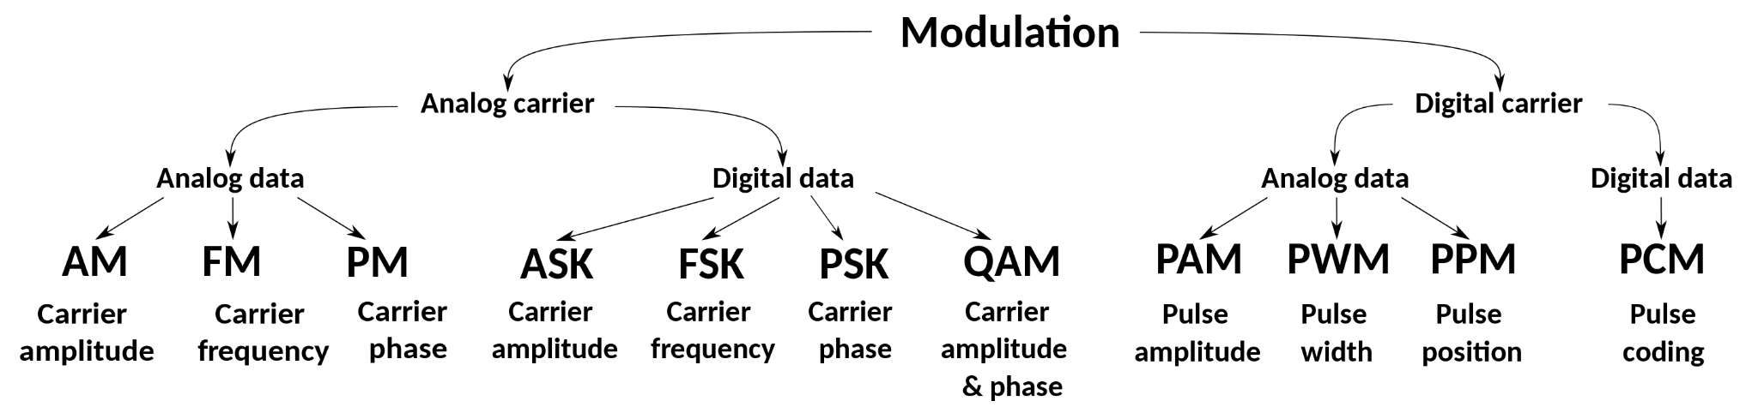
Modulation
Purpose of Modulation:
Increases bandwidth of transmitted signal
Optimizes signal for channel pass-band frequencies
Decreases amount of noise from channel
Reduction of physical circuits (aka antennas, vias/trace widths/board height)
Easier Multiplexing of signals (needed for video data transmission)
Message Frequency: Frequency of message signal
Carrier Frequency: Frequency of carrier
In frequency-division multiplexing, bandwidth of channel can be separated into frequency bands such that each channel can have multiple messages communicating at the same time on different frequencies, which shows the need of the higher frequency carrier wave/modulation

Slide 5
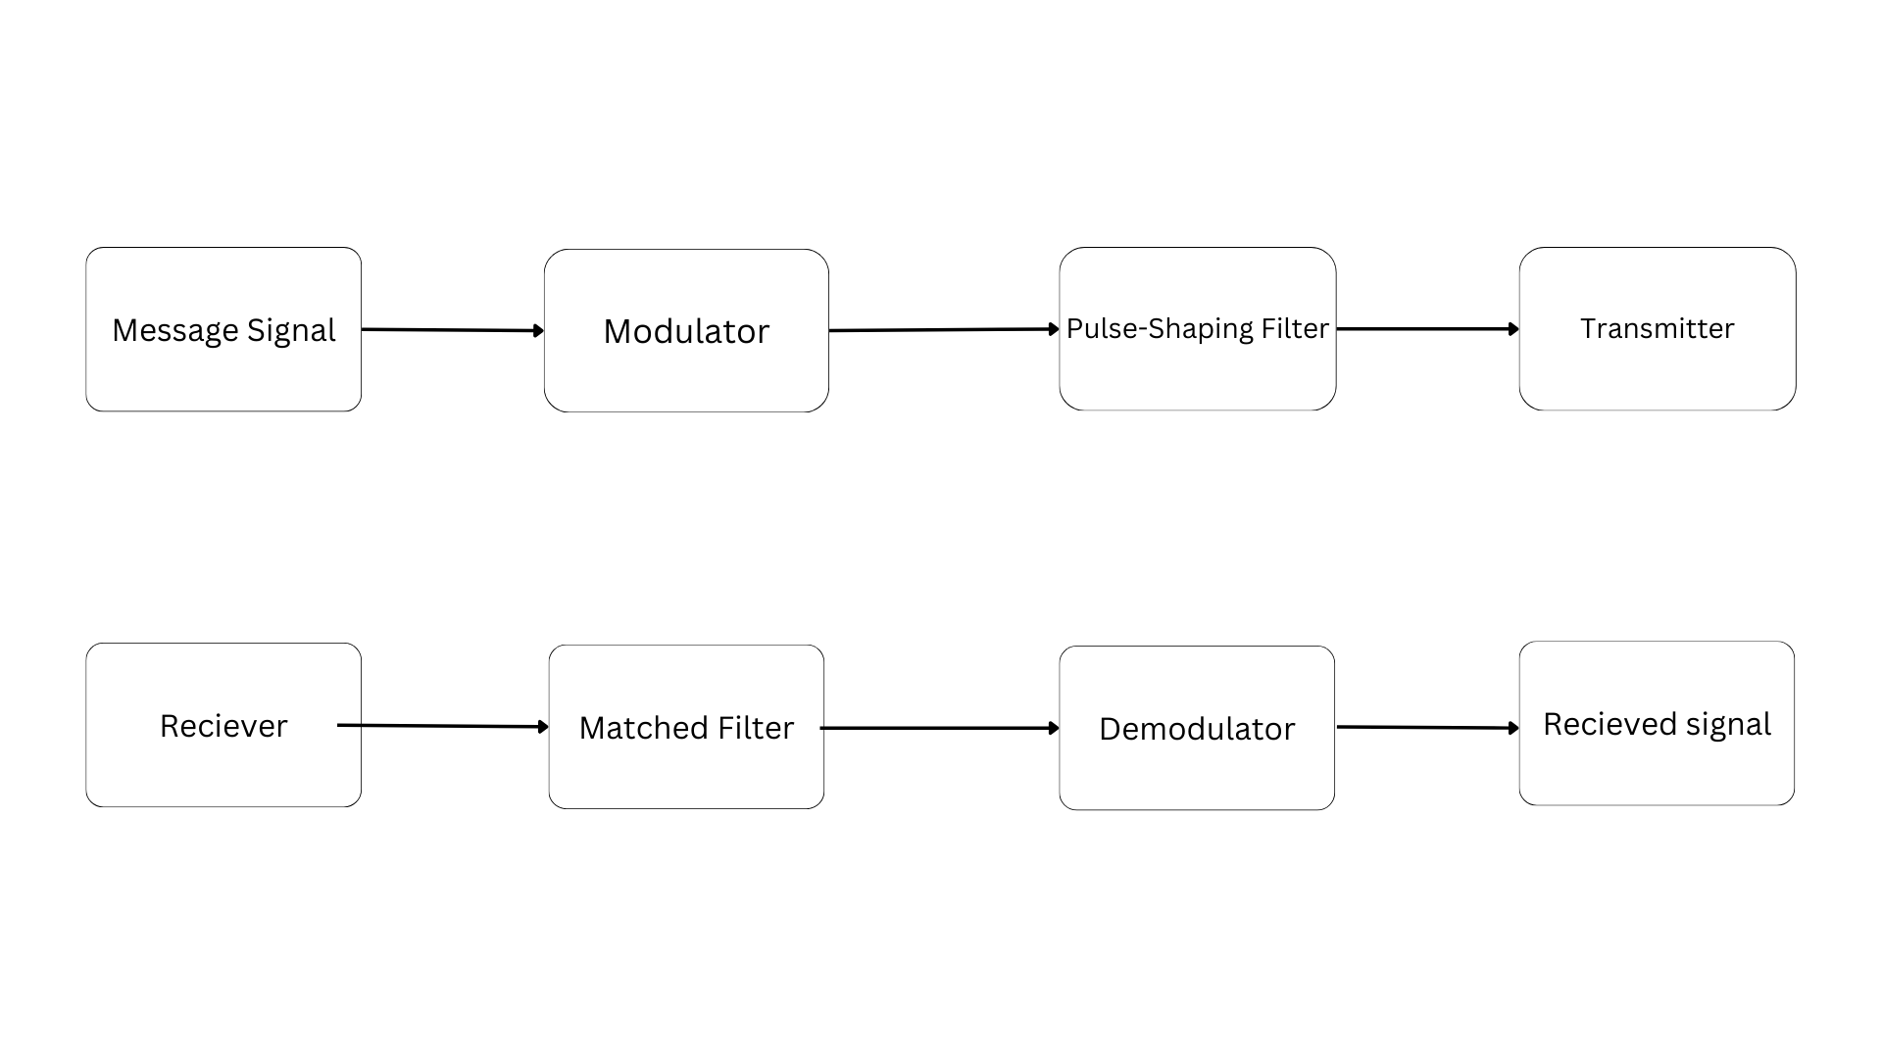
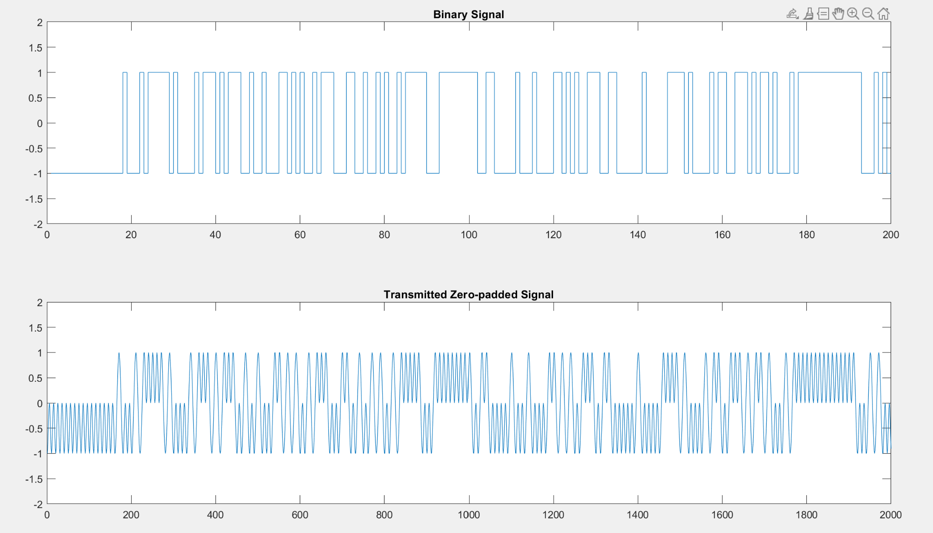
2-PAM
Modulator: Upscales message frequency from 4.8k to 48k (zero pads 9 bits for every 1 data bit)
Pulse Shaping Filter: converts digital signals to an equivalent analog waveform
Digital signals have infinite bandwidth, but channels often don't
When sending over digital data, if the channel is long, signal will be distorted
Matched Filter: helps to remove noise/improve SNR from channel
Demodulator: removes zero-pads/downsampled down back to 4.8k
2-PAM used in GDDR6, 10BASE-T ethernet, and DSL systems

Slide 6
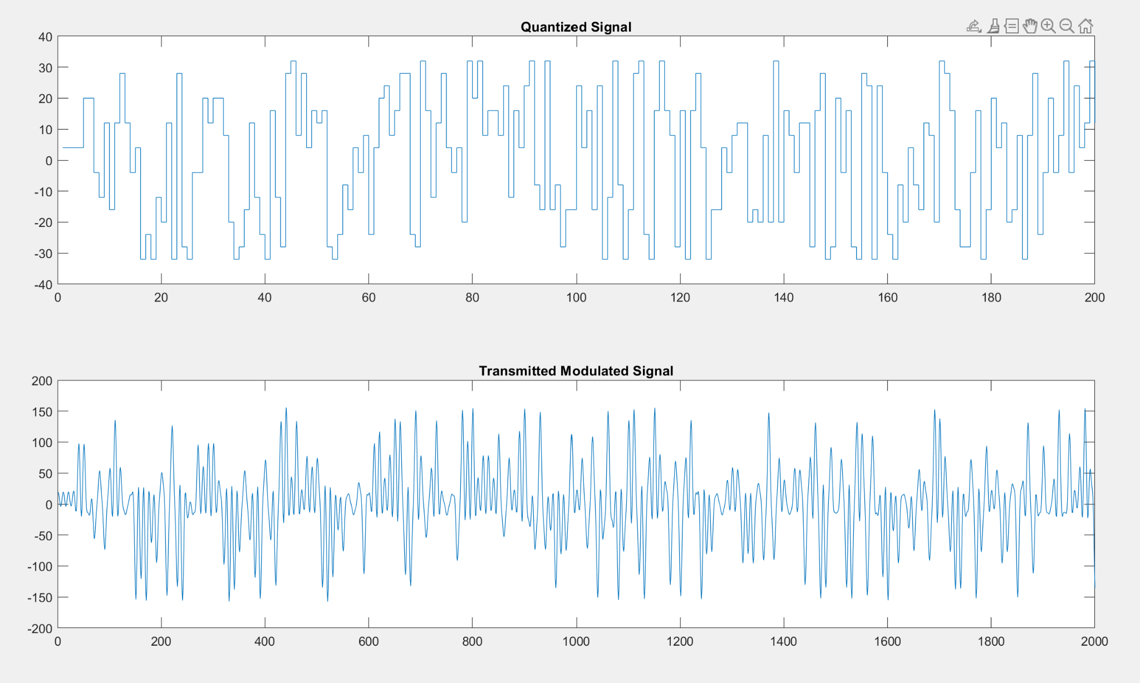
Higher Order PAM Schemes
PAM can also represent more bits for each data symbol
M-PAM represents log2(M) bits
2-PAM represents 1 bit, 4-PAM represents 2 bits, 16 PAM represents 4 bits
Given the same channel bandwidth, 16-PAM can send 4x the bits/sec as 2-PAM
As modulation order goes higher, there is a higher bit-error rate as well as a generally consuming more power in the same amount of time as well
3-PAM used in USB4, 100BASE-T4 ethernet, GDDR7. 4-PAM used in GDDR6X, 200 gigabit ethernet, PCI express 6.0.
16-PAM signal (-32 to 32 in 4 level increments)

Slide 7
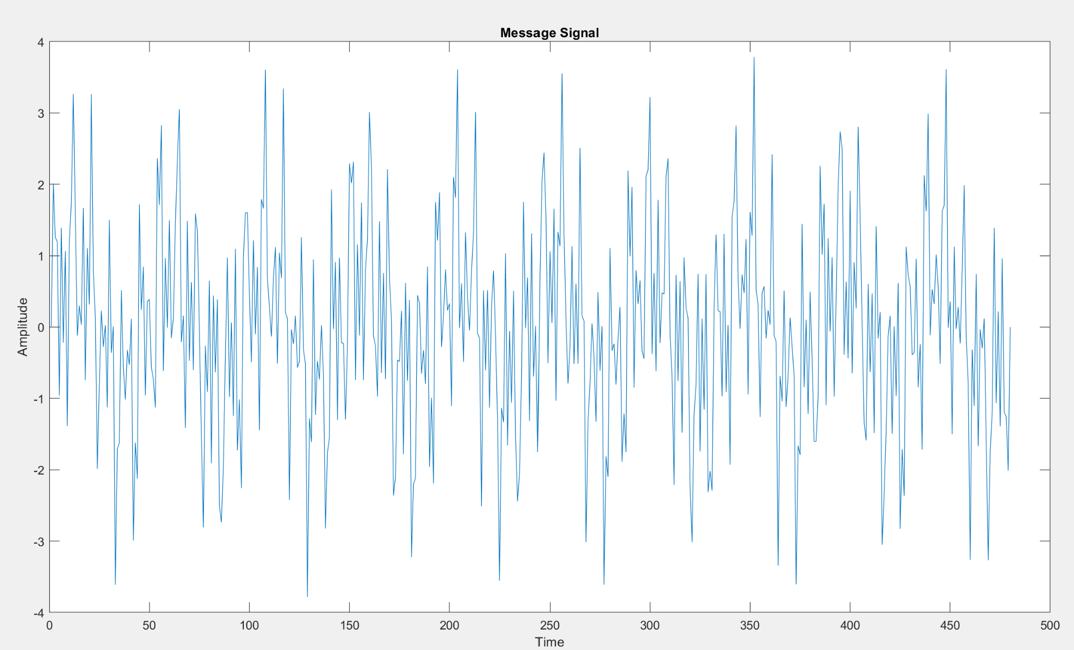
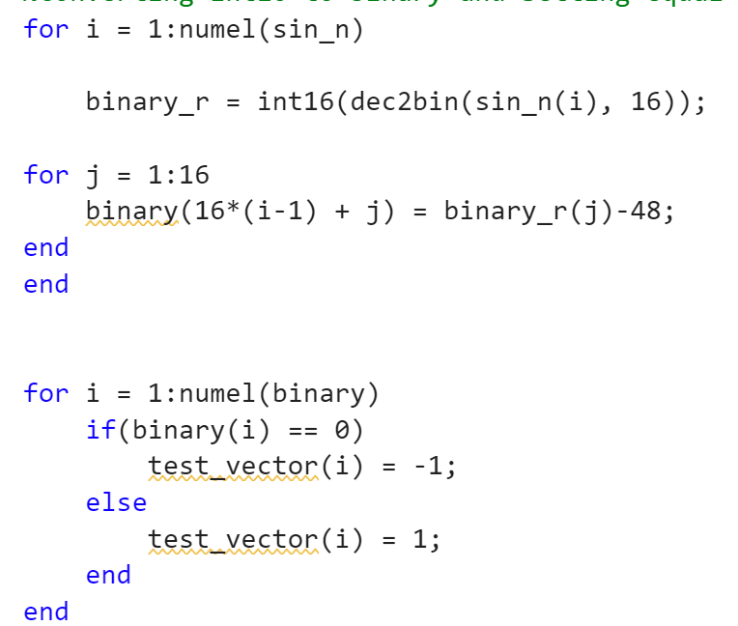
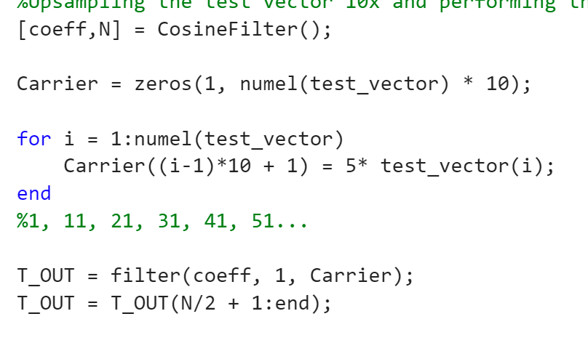
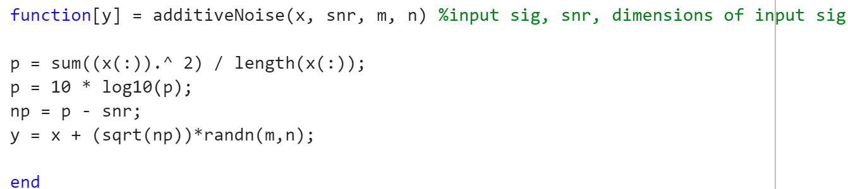
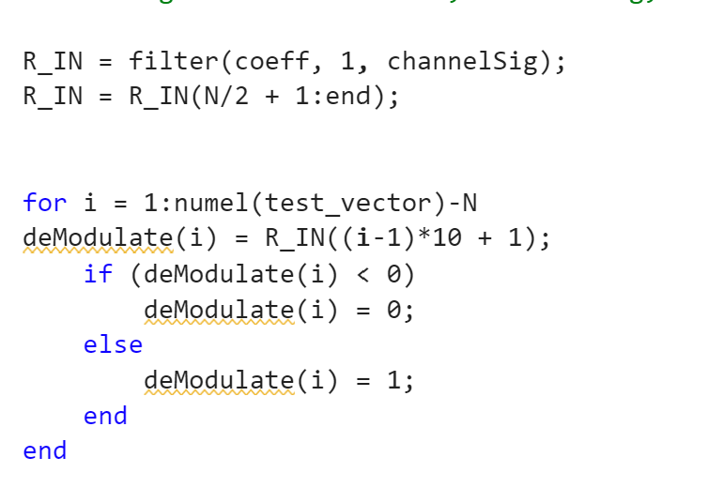
MATLAB Implementation
Began with MATLAB in order to find optimal filter coefficients, creating test vectors and creating a vision for implementing 2-PAM elsewhere
MATLAB 2-PAM Implementation:
Create the 16-bit message signal
Convert the 16-bit message to binary 1’s and -1’s
Zero-pad and filter signal, then transmit it
Add channel noise (based on power of signal)
Receiver filters again, then converts to 0’s and 1’s

Slide 8
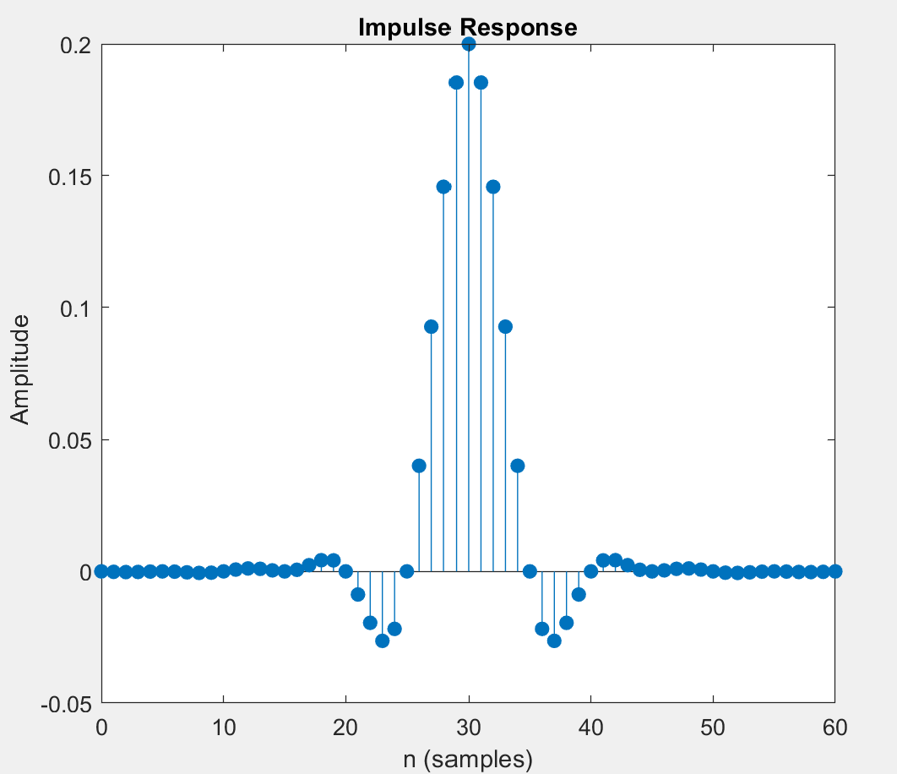
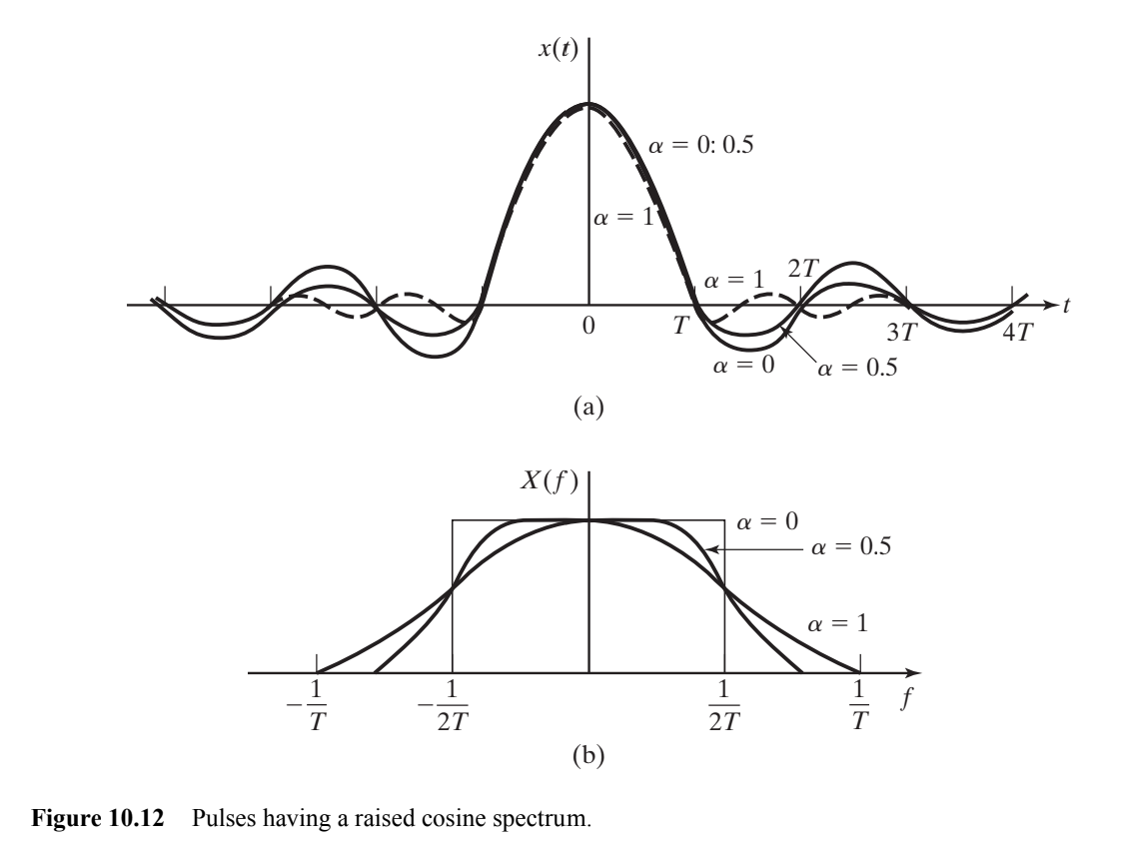
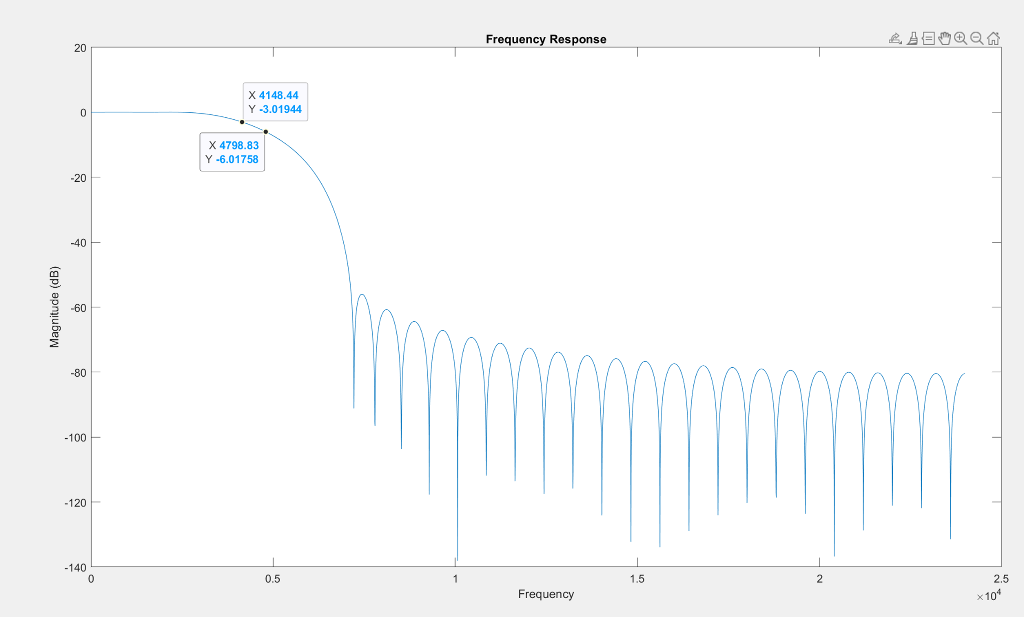
Pulse shaping Filter
Raised-Cosine Filter: used as the pulse shaping filter/matching filter
Narrow sidebands result in easy way to define bandwidth of signal
Roll-off (α) determines the bandwidth of the signal (lower roll off, steeper cutoff)
Same delay of N/2 as normal FIR filters (equiripple, least squares)
Reduces power consumption from higher frequency harmonics
Fig 10.12 Proakis and Salehi Fundamentals of Communication Systems

Slide 9
Results Criteria
Effects of transmit Power and SNR/noise on bit errors and transmit speed

Slide 10
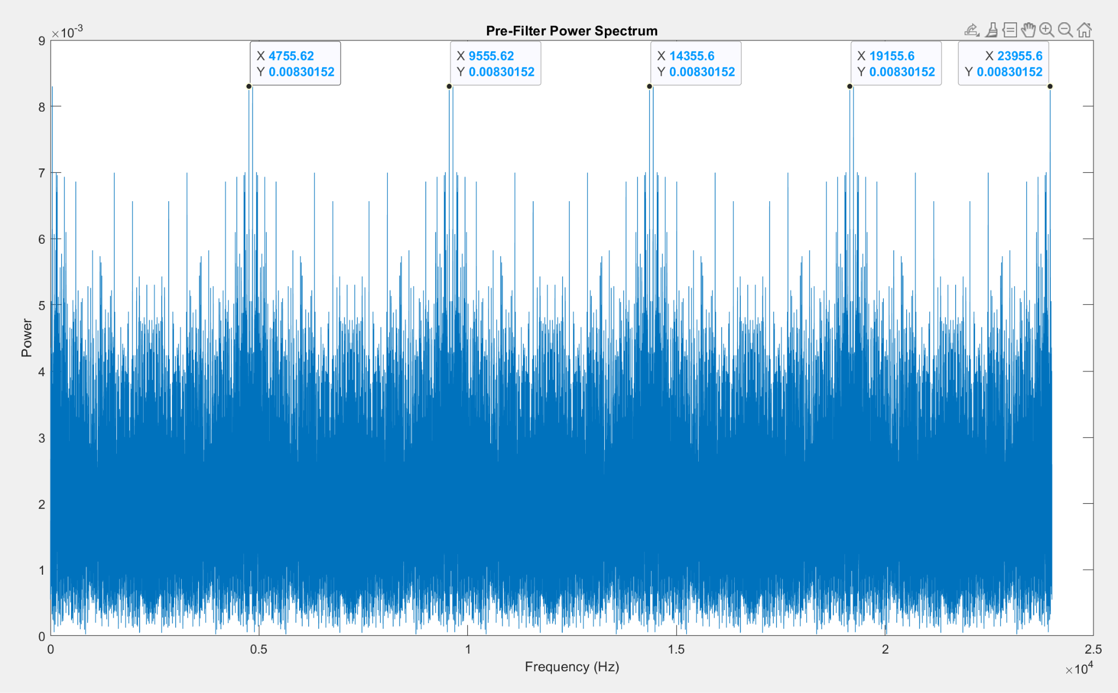
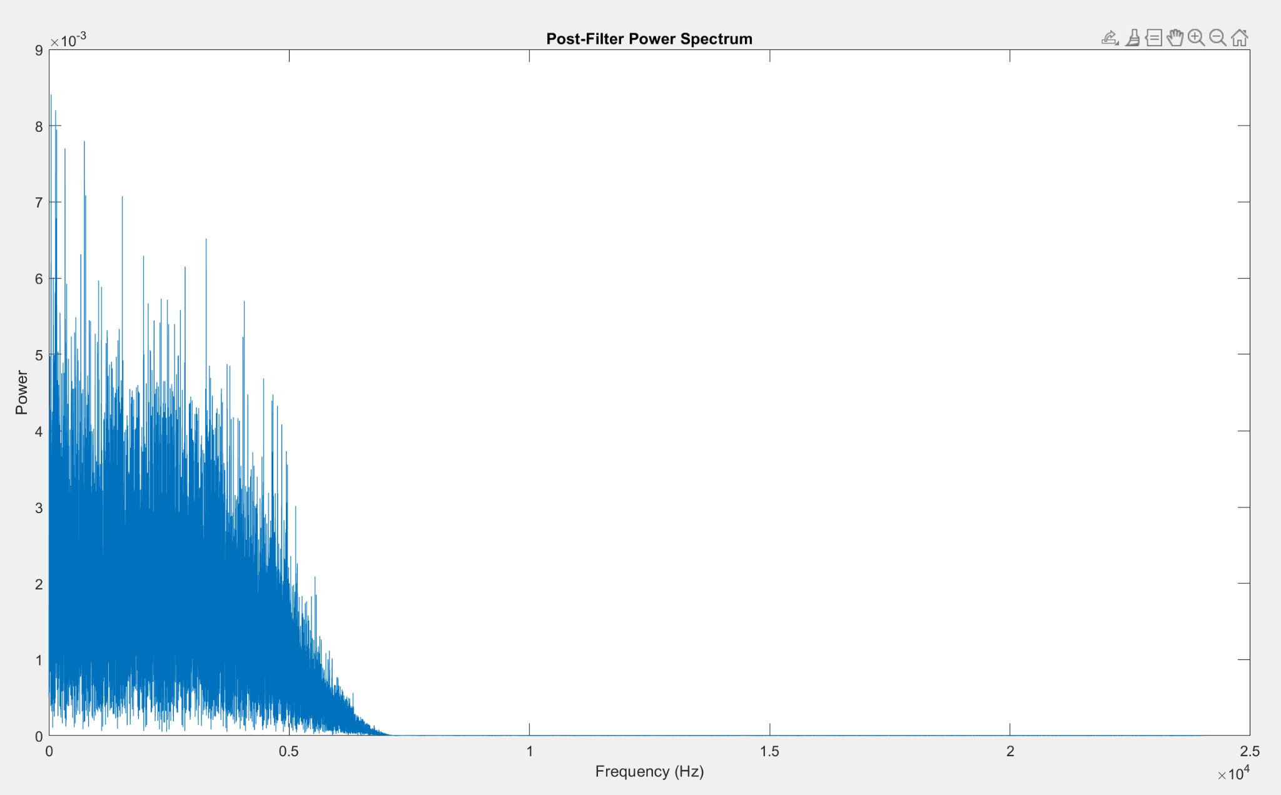
Power Spectrum
Total Power in signal = Σ(x[n]^2)
Total Power Pre-filtering: 7680 W
Total Power Post-Filtering: 1331 W
-Because it’s being transmitted in 1’s and -1’s instead int16 numbers, the spectrum won’t have peaks as expected.
-Peaks will pop up as multiples of 4800, which was the original message frequency

Slide 11
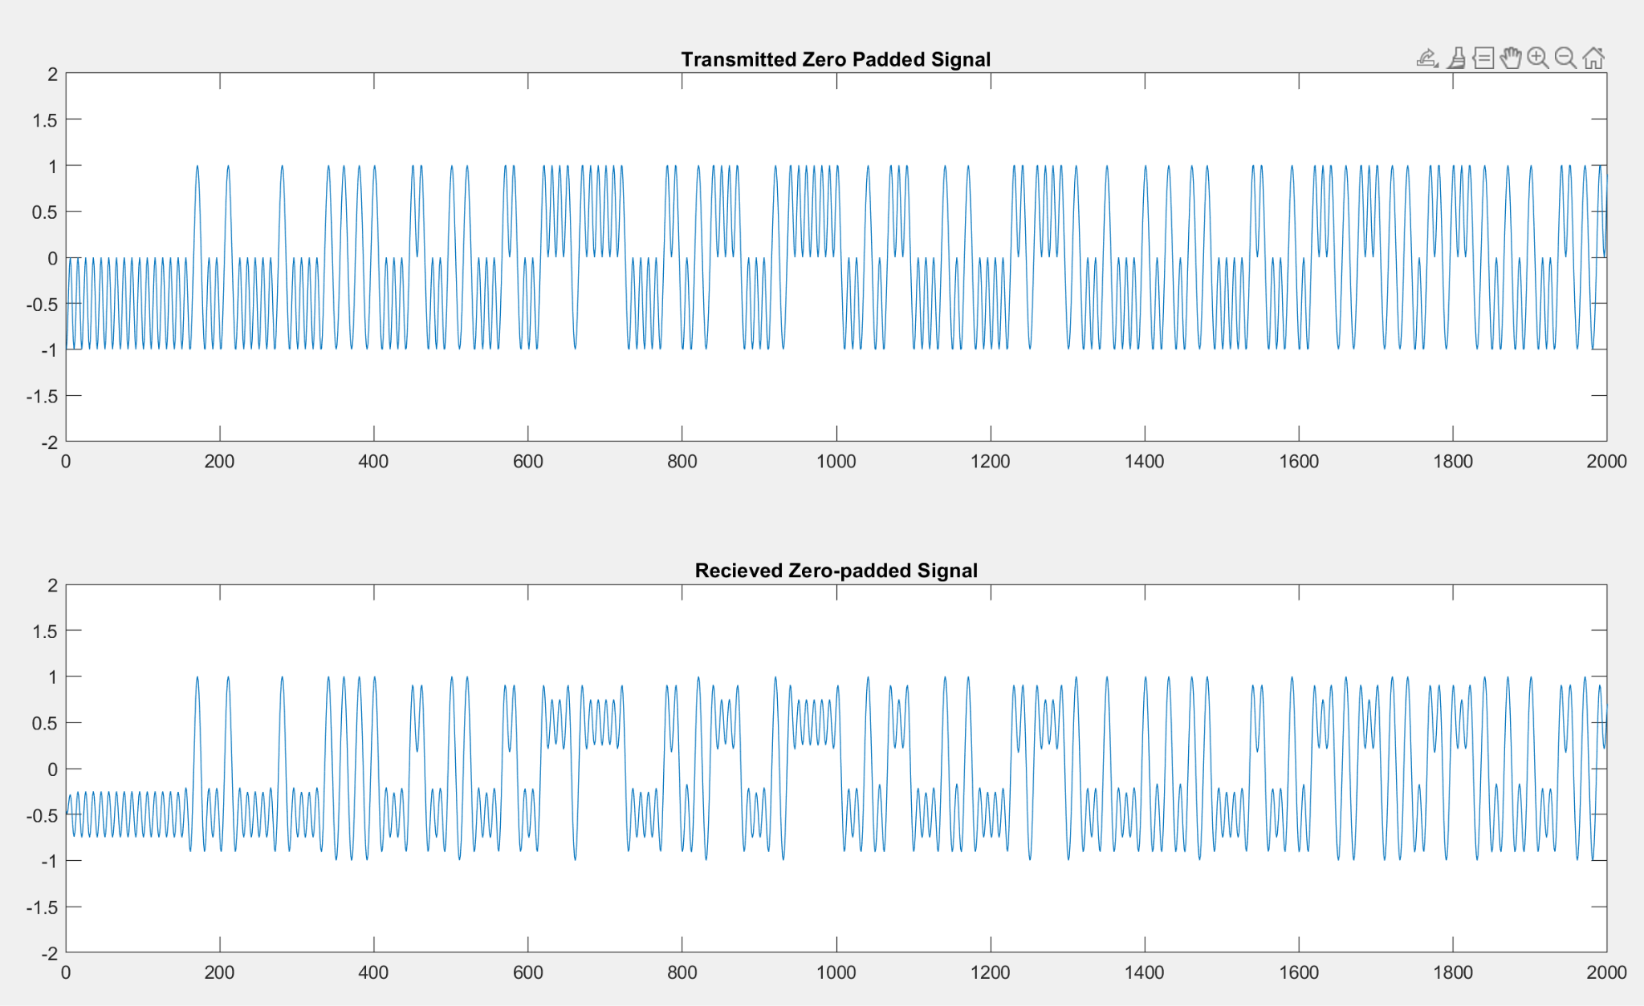
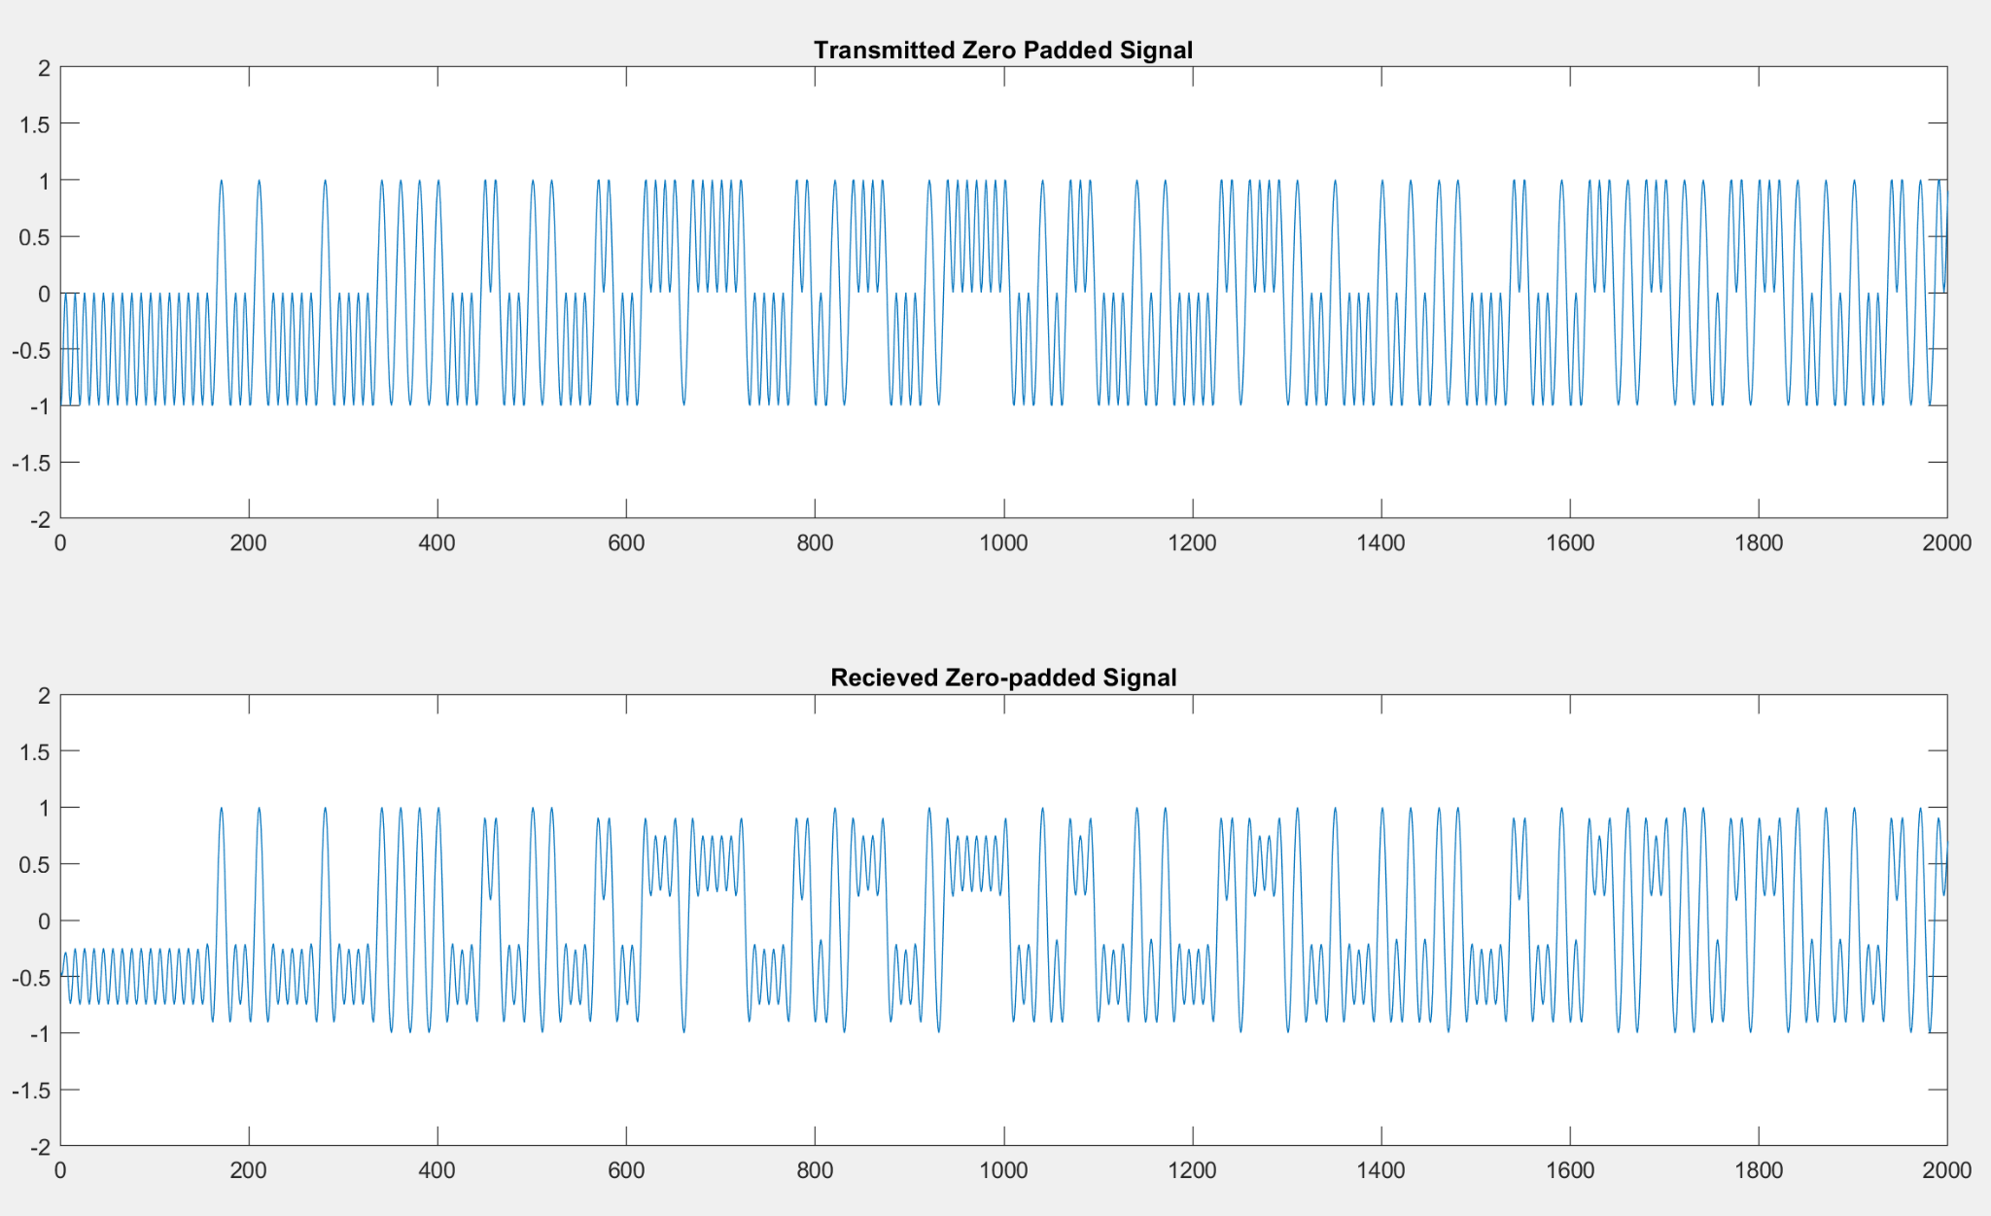
Effects of SNR on PAM
10dB SNR, 0 bit errors
-3dB SNR, 0 bit errors

Slide 12
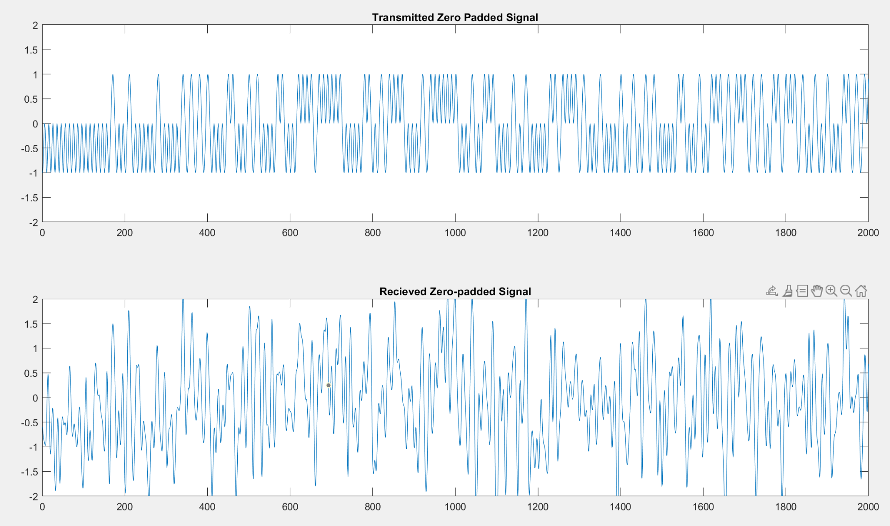
Effects of SNR on PAM Cont.
-6dB SNR, 700 (1/11 total) bit errors
Because 2-PAM uses two levels (either high (+1) or low (-1)) it’s highly resistant to white noise
Higher order PAM schemes, depending on types of quantization, suffer much more from SNR

Slide 13
Embedded Code Implementation
“Transmission”:
All Numbers in Q15 format
Convert each Int16 into 16 Int16s, either 1 or 0 (bit extraction)
Convert each Bit into a PAM symbol (either 1 or -1)
Used 1000 and -1000 because of filter attenuation
Upsampled by 10
7680 total samples (48*16*10)
Filter with raised cosine to modulate
61 taps
Add noise to simulate transmission medium
“Receiving”:
Filter with exact same raised cosine to demodulate
Downsample and convert symbols to 1s and 0s
Accounting for total filter delay of 60 samples
Reconstruct original numbers

Slide 14
Embedded Code Results
Embedded Code Info:
Timing:
Tx and Rx timing are nearly identical
1.3 mS for each according to O-Scope Captures
~37,000 Bits per Second. Well above 4,800
No BIOS used
For demonstration Purposes
With proper electronics, BIOS would likely be highly useful
Noise Generation
randn() used for noise
Uniform RV instead of Gaussian
SNR input to determine noise level

Slide 15
Demo Time!

Slide 16
Any Questions?

